Slide 1
Business Analytics-Elective
JUNAID AHMED

Slide 2
Course Introduction
The course is all about
Understanding the Business data and its properties.
  Why We need the data ➔ Solve the problems
  What data is needed ➔ Depending upon the problem.
  The Fundamental of Analytics
    Descriptive
    Diagnostic
    Predictive
    Prescriptive

Slide 3
Course Introduction
Visualization
Analytics in age of AI.
Git and Version Control systems
If possible, use of the tools such as Power BI, SQL, and Agentic coding.

Slide 4
How to pass course
Attendance = 1
Mini project = 1 => Submit by October 11, 2026
HomeWorks and Class activity = 1
Final project = 2 => Submit by November 6, 2026

Slide 5
What are you studying?
S.No | Field | No
1 | AI and Management
2 | Business Administration (Marketing and HR)
3 | Accounts, Finance and Economics
4 | Social Science-Psychology, Sociology etc.

Slide 6
Python Knowledge
How many of you have taken any course of python?
Do you want a smaller introduction of python syntax?

Slide 7
Sallybus

Slide 8
Day 1: Basic Git hub, Data and Data analytics, Social network analysis, Types of data Structured Vs Unstructured, Collecting data (primary, secondary, big web data-API & Web scrapping). Fundamentals of the Cross Section, Timeseries and Panels data
Days 2: Hands on Analytics using Exploratory Data analytics (Descriptive and Diagnostic), Importance of Visualization and storytelling. Data Analytics-Cross Sectional Analytics (Descriptive, Diagnostic, and Predictive Analytics), Fundamentals of experimental, A/B Analysis
Days 3: Unstructured Data and Analytics + Social network analysis
Days 4: Timeseries and Panels Data Analytics
Day 5: Additional Topics of agentic coding, SQL and PowerBI

Slide 9
Question, Comments and thoughts

Slide 10
Day 1: Fundamental of Analytics

Slide 11
Todays agenda
Hands on Python?
Fundamental of GitHub
Data
Analytics

Slide 12
Python?

Slide 13
Git Hub

Slide 14
An Introduction to Version Control: Git and GitHub
Version Control: A system that records changes to files over time, allowing you to recall specific versions later. Essential for collaborative work and maintaining project history.
Git: A distributed version control system created by Linus Torvalds in 2005. Tracks changes locally and facilitates collaboration among developers.
GitHub: A web-based platform for hosting Git repositories. Offers tools for collaboration, issue tracking, and code review.
Facilitates teamwork with features like branching, merging, and pull requests. Ensures code safety with backup and versioning capabilities. Encourages transparency and open-source contribution.

Slide 15
Versioning
Take snapshot of changes
View History
Revert back

Slide 16
Hands on Git hub Workflow
Create a repo on GitHub
Clone
Work on files
Commit and Push to origin

Slide 17
Working with terminal

Slide 18
Working with github
Open your laptop terminal and type
git –-version
Incase: 'git' is not recognized as an internal or external command, operable program or batch file.
Installation-Windows
Go to: https://git-scm.com/install/windows
During installation, make sure “Add Git to PATH” is selected

Slide 19
MacBook
Install homebrew
/bin/bash -c "$(curl -fsSL https://raw.githubusercontent.com/Homebrew/install/HEAD/install.sh)"
And than
$ brew install git
Notes:
pip install notebook pandas matplotlib
In case notebook is not installed

Slide 20
Working with GitHub
Most developers and data scientist tend to work locally by
Cloning a repo
Working locally
Making a changes by pushing it on github.

Slide 21
Now its your turn Working in the Github
1. Account Please retrieve your account- I wait 3 minutes.
2. Local machine terminal. Essential but we can also work in terminal provided by code editor.
3. Essential git commands.

Slide 22
4 Essential Git Commands
git clone command: Allow you to clone a github repo into local machine.
git clone https://github.com/Kozminski-Network-Business-Analytics/intro_to_github.git
2. cd folder_name: allow you enter into github folder
cd intro_to_github
3. Creating code editor: Allow you to create and open a code editor.
code .
4. Pushing code editor file at github
git add intro.ipynb
git commit -m "Add simple house visualization"
git push origin main

Slide 23
Working with jupyternotebook from anaconda
Open Anaconda Prompt
Navigate to your folder by
cd {folder direrctory}
Most of jupyter working is in specific folder. So be aware of that.
Same procedure
git clone {web directory from github}
Notes:
E:
In case of the another derive

Slide 24
Virtual Environment
Effective way of working on a new project
Manage packages effectively
Help to reduce conflict in between different packages and version.

Slide 25
Essential commands
conda env list
conda create --name {myenv} python=3.11
conda activate {myenv}
conda deactivate

Slide 26
Let’s Do practices

Slide 27
Code Editor Settings: Jupyter Notebook
In the entire course, we will work on jupyter notebook which provides python environment called Interactive Python Notebook (Ipynb).
Allows you to run code in separate cells interactively, enabling step-by-step testing and debugging.
Supports markdown cells for adding explanations, headings, and mathematical equations alongside code. This makes it excellent for documentation and reporting.

Slide 28
Data And Analytics

Slide 29
Data:
Data refers to raw facts and figures that can be collected, stored, and analyzed to gain insights.
Data can be structured (e.g., databases, spreadsheets) or unstructured (e.g., text, images, videos).
Data is generated from various sources such as sensors, social media, transactions, and user activities.
Big data refers to extremely large datasets that are too complex or voluminous for traditional data processing tools to handle, requiring advanced technologies like Hadoop and machine learning to analyze and derive value.

Slide 30

Big Data framework
Volume
Velocity
Variety
Veracity

Slide 31
Volume
Definition of Volume: Volume refers to the sheer scale of data generated every second, ranging from kilobytes to terabytes and beyond.
Data Sources: High data volume comes from sources like social media, IoT devices, e-commerce, and multimedia content.
Storage Challenges: Managing and storing vast amounts of data require scalable solutions like cloud storage and distributed systems.
Relevance in Big Data: Volume is a defining characteristic of big data, emphasizing the need for technologies to process massive datasets efficiently.

Slide 32
Variety
Variety refers to the different types and formats of data, ranging from structured to unstructured and semi-structured.
Data Formats: Includes text, images, videos, audio, sensor data, logs, and more.
Integration Challenges: Combining diverse data types into a cohesive analysis framework requires specialized tools and techniques.
Relevance in Big Data: Variety highlights the complexity of big data, emphasizing the need for flexible systems to handle heterogeneous datasets.

Slide 33
Velocity
Definition of Velocity: Velocity refers to the speed at which data is generated, collected, processed, and analyzed.
Real-Time Data Sources: Includes streams from IoT devices, social media updates, financial transactions, and online interactions.
Processing Challenges: Managing and analyzing high-speed data streams requires real-time processing technologies like Apache Kafka and Spark.
Relevance in Big Data: Velocity emphasizes the need for systems that can handle continuous data flow and provide actionable insights in real time.

Slide 34
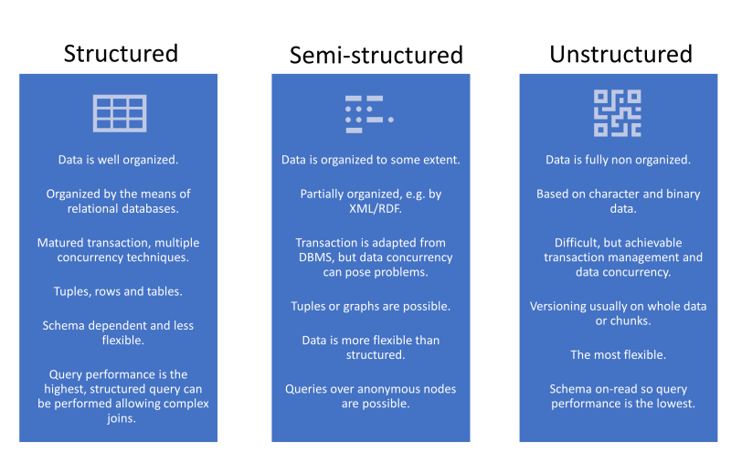
Structured and Unstructured Data

Slide 35
Data types from perspective of Analytics
Cross Sectional
Timeseries
Panel Data

Slide 36
Fundamental of Analytics

Slide 37
Types and Level of Business Analytics
Descriptive
Diagnostics
Prescriptive
Predictive

Slide 38
Comparison
Type of Analytics | Purpose | Techniques
Descriptive | To Describe the data itself. What is in the data or what does data shows | Mean, median, sum and others
Diagnostic | (a) Reason behind what is being depicted description of data. (b) understanding a cause of any inconsistencies | Correlation, Cronbach alpha, and others
Predictive | Finding a relationship in between two variables of data and estimating an effect | Regression, mean difference, machine learning and etc.
Prescriptive | Suggesting a course of action and outcome as result of such action. | Simulations and machine learning.

Slide 39
Techniques of Descriptive Analytics
Measure of Frequency
Central Tendency
Measure of Dispersion
Variability

Slide 40
Diagnostics Analytics
Diagnostic analytics is the process of using data to determine the causes of trends and correlations between variables.
Diagnostic analytics examines data to understand the root causes of events, behaviors, and outcomes.
It can be viewed as a logical next step after using descriptive analytics to identify trends.

Slide 41
Techniques of Diagnostic Analytics
Data Preprocessing
Correlations

Slide 42
Predictive Analytics
Predictive analytics is the use of data to predict future trends and events based on historical data.
The predictions could be for the near future and distant future.
Both Traditional econometric and modern machine learning is being used.
The techniques differ significantly based on nature of data.

Slide 43
Predictive Analytics
Regression
Machine Learning
Mean Difference
Time-Series Forecasting
Panel Data Analytics

Slide 44
Prescriptive Analytics: Data Drive Decision Making
Prescriptive analytics is the process of using data to determine an optimal course of action. By considering all relevant factors, this type of analysis yields recommendations for next steps.
Machine-learning algorithms are often used in prescriptive analytics to parse through large amounts of data faster—and often more efficiently—than humans can.
Using “if” and “else” statements, algorithms comb through data and make recommendations based on a specific combination of requirements.

Slide 45
Prescriptive Techniques
Predefined Rules to Choose an Alternative
Optimizations

Slide 46
Important Consideration Before Analytics.
It is not calculation and computation which matters in analytics.
What truly matters is having the right combination of the objective, the data type, and the analytical approach.
So, following is perfect guide and cheat sheet.

Slide 47
Typical Analytical Flow
Objective of Data Analytics
Collection of data
Understanding Sequence
Interpreting results
Applying those techniques
Choosing Mix of techniques

Slide 48
Exercise 1:
Business Problem
What will be Sales of Ice cream brand of Oreo in Winter?
Source of Data and sequence of data
Add
Type of Analytical techniques
Add

Slide 49
Exercise 2:
Business Problem
What will be effect of new advertisement campaign on the Sales
Source of Data and sequence of data
Add
Type of Analytical techniques
Add

Slide 50
Exercise 3:
Business Problem
What will be percentage of return on AI stocks in near future?
Source of Data and sequence of data
Add
Type of Analytical techniques
Add

Slide 51
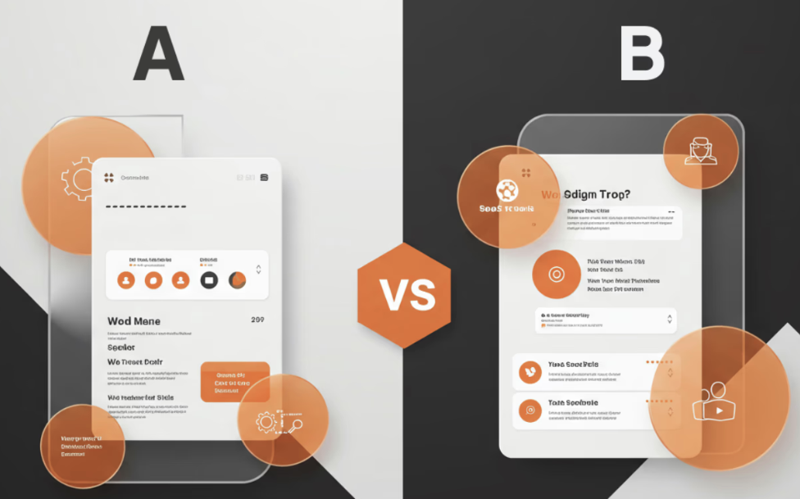
Look at following
Notes:
Reference: https://framerusercontent.com/images/Y6gJ9PWVnJVc6f0RHAdRl6QaE.png?width=1450&height=1023

Slide 52
Exercise 4:
Business Problem
Which UI of our new app will be easy to use?
Source of Data and sequence of data
Add
Type of Analytical techniques
Add

Slide 53
Cheet Sheet of Choosing Right Analytical techniques

Slide 54
Cheat Sheet
What is aim of Analytics: (a) Descriptive (b) diagnostic (c) predictive
How data is collected: → Surveys → Census → Experiments → Transactional data (Sales, Share price etc.) → Digital trace data (likes, comments and etc.).
What Sequence data possess: → cross sectional → time → panel
Analytical techniques→ Range of such techniques falling diagnostic and predictive.

Slide 55
Data Analytics Vis-Via-Sequenece

Slide 56
Time series
S.No | Aim | Techniques
1 | Understanding patterns and trends over time | Line Plots, Moving Averages, Decomposition
2 | Diagnosing relationships across time | Cross-Correlation, Granger Causality, Autocorrelation
3 | Predicting future values | ARIMA, SARIMA, Exponential Smoothing, LSTM, Prophet
4 | Prescribing actions based on forecasts | Scenario Analysis, Inventory/Capacity Planning, Optimization based on Forecasts

Slide 57
Panel Data Analytics
S.No | Aim | Techniques
1 | Diagnosing relationships between variables over time and across entities | Fixed Effects Model, Random Effects Model, Correlation, Granger Causality
2 | Understanding differences between groups or entities over time | Difference-in-Differences (DiD), ANOVA for repeated measures, Mixed Models
3 | Predicting outcomes using past and current data | Panel Regression, Dynamic Panel Models (e.g., Arellano-Bond), Machine Learning Models with temporal features
4 | Prescribing actions based on insights and forecasts | Scenario Analysis, Policy Simulation, Optimization based on panel forecasts

Slide 58
Conclusion
So, starting from now, we will explore multiple dataset and apply these techniques.
QUESTION, COMMENTS and SUGGESTION.

Slide 59
Sources of Business Data

Slide 60
Data
Primary Data
Survey
Interviews
Focus group discussion
Secondary Source
The data which is second-hand in nature meaning already collected and reported (e.g. stock price) by other (government, companies, individual).
Most of course focuses upon secondary source of data.

Slide 61

Open Access Datasets: Traditional Sources
https://datasetsearch.research.google.com/
https://data.gov/

Slide 62

Some more
Kaggle.com
huggingface.com

Slide 63
10 minute exercise
Think of a problem, business, social, economic or cultural
Search suitable data that can be used to address this problem

Slide 64
2. Third party Data
There are specialized companies and agencies which provides various kinds of the data used for addressing business problems and opportunities.
These companies utilize a method to collect the data which is scientifically validated methods.
Some methods can be very simple such as surveys, interview and focus group discussion. Some data can be as result of data monitors as utilized by Bloomberg.
Other companies include Nielson, Young and Rubicom and others.

Slide 65
3. Propriety data sources
Definition: Proprietary data is exclusive, privately owned information collected and controlled by a specific organization.
Types of Data: Includes customer purchase history, internal business metrics, and confidential research data.
Applications: Used for competitive advantage, personalized marketing, and strategic decision-making.

Slide 66
4. Digital Source of Data: A Glodmine
The publicly available data mostly in form of unstructured data such as discussion on the social media, websites information and other is considered to be goldmine data.
Allegro product listing to social media comments and discussion is data which is already public and can be utilized for research and the solving business problems
Ethical: Any data which can seriously threaten the emotional-physical wellbeing is subject to ethical standards.
However, legality issues remains persistent and debatable.

Slide 67
Digital Source of Data: Application programming interface
An API is a set of rules and protocols that allow different software systems to communicate with each other and exchange data.
APIs provide structured data in formats like JSON, XML, or CSV, often with real-time access.
APIs are widely used to retrieve data from online services, such as social media platforms, financial systems, weather services, and databases, enabling integration across platforms
APIs offer controlled, secure access to data and enable automated data retrieval without manual scraping, reducing data extraction complexity and ensuring reliable, real-time data flow

Slide 68
Want to test API?

Slide 69
Web Scrapping
Web scraping is the automated process of extracting data from websites by parsing the HTML content of web pages.
Ensure compliance with the website’s robots.txt and terms of service, and avoid excessive requests to prevent server overload.
The webscrapping is an important source of the for big data, and innovation implications.
It is also being suspected that, Wikipedia was scrapped and its data been used for the development of large language models (LLM)

Slide 70



Common frameworks

Slide 71
Steps
Identify website
Send a Request and obtain HTML elements
Parse and Locate the data of interests
Extract and store Data

Slide 72
HTML
Explain that HTML (HyperText Markup Language) is the standard language used to create and design webpages. It structures the content using elements such as tags, attributes, and text.
Key HTML Elements: Introduce common HTML tags like:
<html>, <body>, <head>
Structural tags: <div>, <header>, <footer>
Content tags: <h1>, <p>, <ul>, <li>, <a>, <span>
Attributes like id, class, href, src, etc.

Slide 73
For example: Identifying, locating and extracting the Book title
<h3><a href="book_link" title="Book Title">Book Title</a></h3>
soup.find('h3')

Slide 74
So, May be we are ready for the web scrapping as well.

